Slide 1
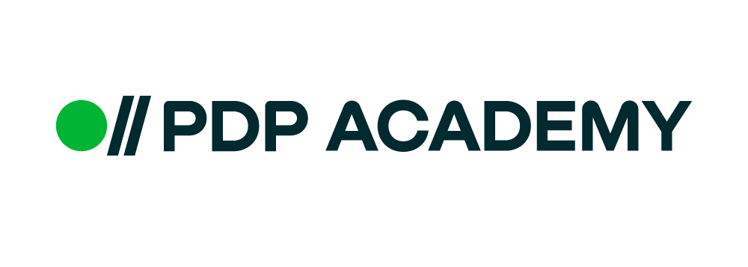
PL/pgSQL

Slide 2
PL/pgSQL
PL/pgSQL (Procedural Language/PostgreSQL) is a procedural programming language supported by the PostgreSQL. Implemented by Jan Wieck, PL/pgSQL first appeared with PostgreSQL 6.4, released on October 30, 1998. Since PostgreSQL 9.0, PL/pgSQL is installed by default. PL/pgSQL, as a fully featured programming language, allows much more procedural control than SQL, including the ability to use loops and other control structures. SQL statements and triggers can call functions created in the PL/pgSQL language. The design of PL/pgSQL aimed to allow PostgreSQL users to perform more complex operations and computations than SQL, while providing ease of use.
PL/pgSQL procedural language is similar to the Oracle PL/SQL. The following are reasons to learn PL/pgSQL.
PL/pgSQL comes with PostgreSQL by default.
PL/pgSQL inherits all user-defined types, functions, and operators.
PL/pgSQL has many features that allow you to develop complex functions and stored procedures.
wikipedia

Slide 3
Dollar-Quoted string constant
select 'String constant';
select 'I’m a string constant';
select 'I''m also a string constant';
select E'I\'m also a string constant';
The problem arises when the string constant contains many single quotes and backslashes. Doubling every single quote and backslash makes the string constant more difficult to read and maintain.
PostgreSQL version 8.0 introduced the dollar quoting feature to make string constants more readable.
$tag$<string_constant>$tag$

Slide 4
Anonymous block
PL/pgSQL is a block-structured language, a PL/pgSQL function or stored procedure is organized into blocks.
[ <<label>> ]
[ declare
declarations ]
begin
statements;
...
end [ label ];
To execute anonymous block use DO. The DO statement was introduced since PostgreSQL 9.0.
DO $$
<<fb>>
declare
begin
raise info 'Hello PDP';
end fb;
$$;

Slide 5
Interview Questions

